Slide 1

DAB 304 HEALTHCARE PROJECT
GROUP 10 MEMBERS :
HARBIR SINGH SAHI - 0797037
MANPREET KAUR - 0800080
PRATVA - 0766531
RAVI - 0795606

Slide 2


Agenda
Our project is divided into simple steps that were tackled one by one in the order stated below –
Getting the dataset.
Cleaning and visualizing the dataset.
Data pre processing for predictive analysis.
Predictive analysis.
Summarizing our findings.

Slide 3



IntRODUCTION
This is an predictive and descriptive analysis of the New York inpatient dataset. This was done in attempt to better understand the trends in healthcare data namely in total charges vs cost , length of stay compared to patient’s demographics.

Slide 4
About the dataset
Dataset is from the year 2017 from the state of New York , it has information about all the hospitals in the 63 counties. Dataset has lot of features of interest from an analytic standpoint . Key features of interest that we have worked on in this project are as following –
Length of Stay
APR Severity of Illness
APR Risk of Mortality
Emergency department Indicator
Ethnicity
Race
Total Charges / Total Cost

Slide 5
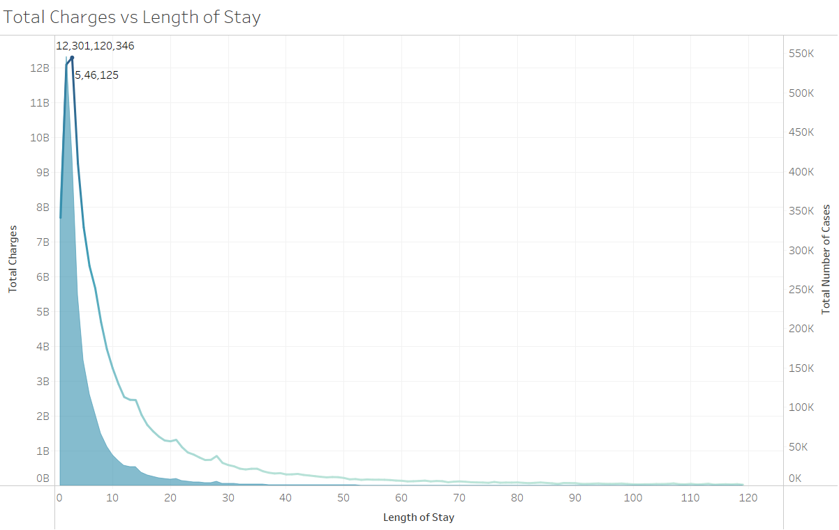
Descriptive analysis
This is a rough graph just to determine if Total charges(or costs) are somewhat proportional to the duration of the stay. The coloured part of the graph represents the Number of cases.
From this we can summarize that amount of patients that spend the most time in hospital range from 2-4 days peaking at 3.

Slide 6
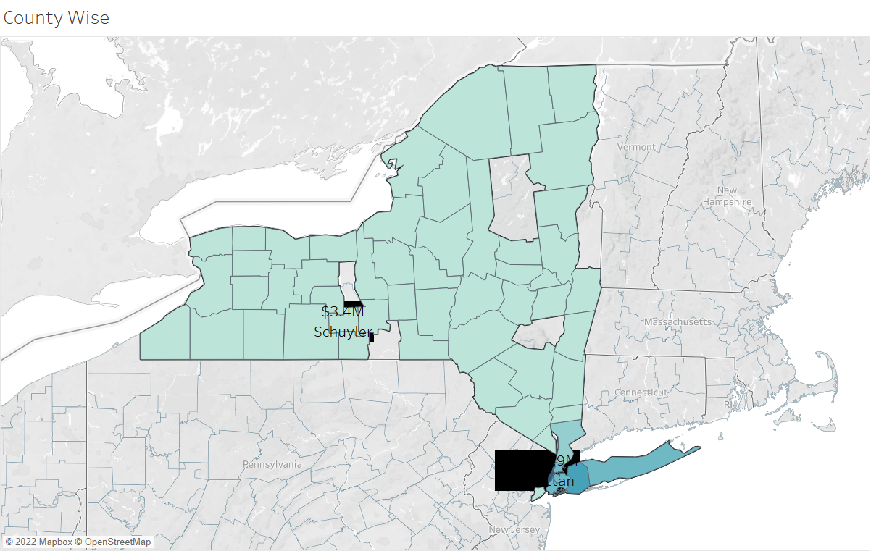
Descriptive analysis
As we can see from the map there is a wide variety in the amount spent for operations across the counties. The most expensive being Manhattan at almost $30bn and the least expensive being Shyuler county with only $3.4 million being spent in the year of 2017 for hospital charges.

Slide 7
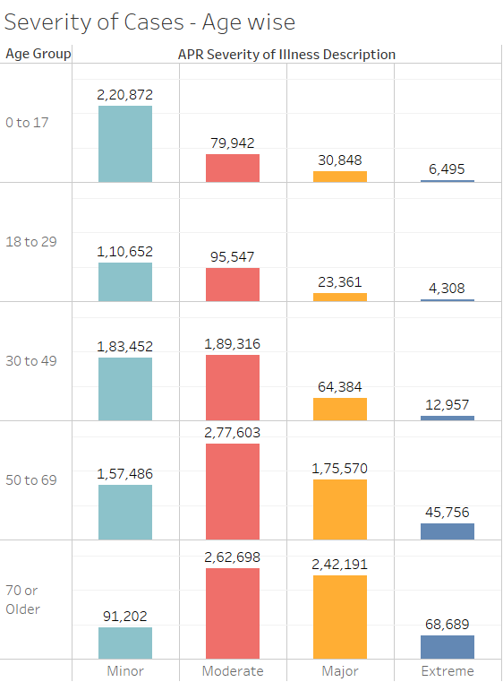
Descriptive analysis
We notice a trend in the Age vs Severity of Cases.
At younger age groups , ie. 0 to 17 ‘minor’ incidents seem to occur the most.
At 70 or more ‘moderate’ and ‘major’ cases seem to dominate the cases for our dataset.
We can safely say from the data that they are inversely proportional to each other.

Slide 8
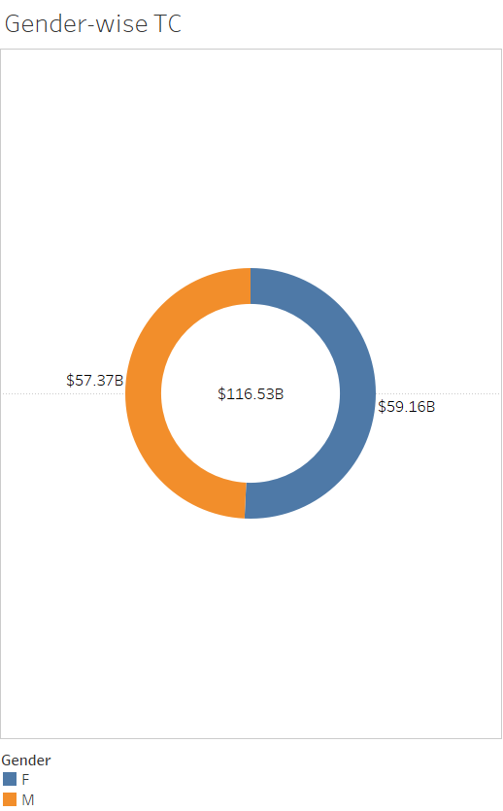
Descriptive analysis
We can also notice that gender does not seem to influence expenditure on healthcare , the expenditure is split almost evenly between both male and female at $57bn and $59bn respectively.

Slide 9
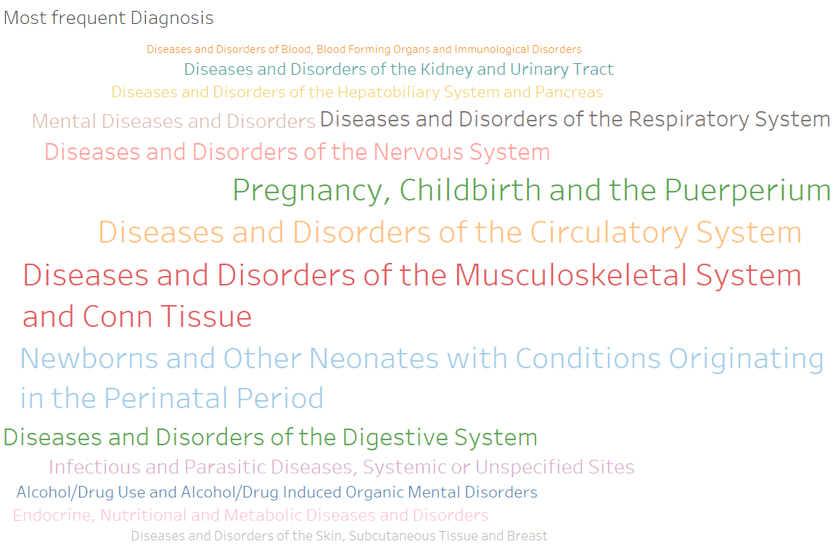
Descriptive analysis
The most common diagnosis in the 2017 is a close contest between Diseases of Musculoskeletal system , Circulatory system and Pregnancy related. They each all have around 45k cases each.

Slide 10
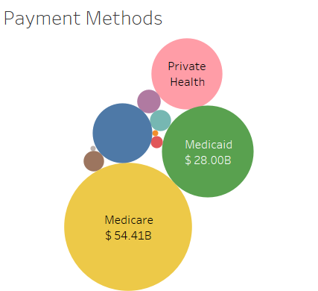
Descriptive analysis
Out of all the payment methods that are available , we can clearly see some of them are more prevalent than the others , Medicare leads the pack with $54bn dollars while Medicaid and private health are 2nd and 3rd respectively.

Slide 11
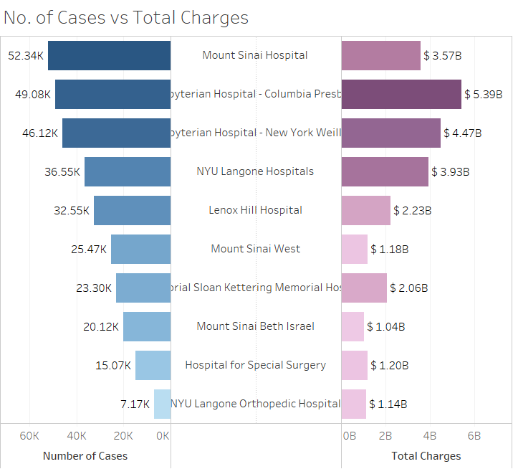
Analyzing the outlier
Out of all the counties that we see in the dataset , the county of Manhattan has the most amount of money spent in hospitals , this is not entirely strange as it also the most amount of cases in the state , this is further breakdown of the 10 of the busiest hospitals in the county and a further breakdown of their cases and the money they charged.

Slide 12
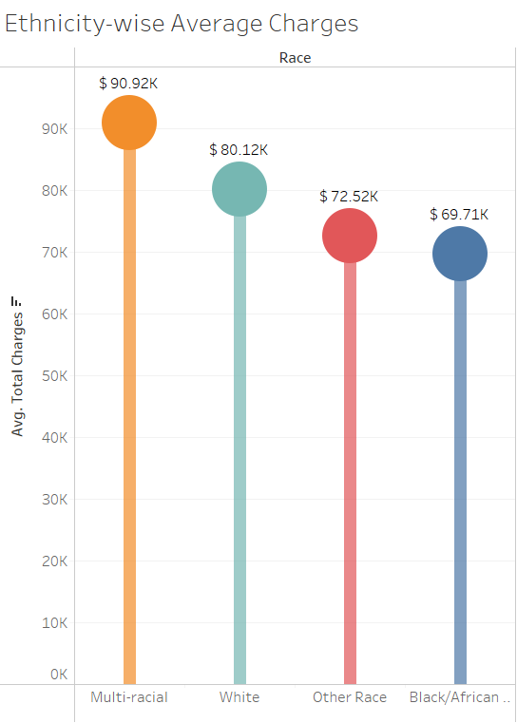
Analyzing the outlier
Interestingly if we compare money spent with ethnicity we see that multi racial people are the ones that spend the most amount of money in Manhattan as compared to the other racial communities.

Slide 13
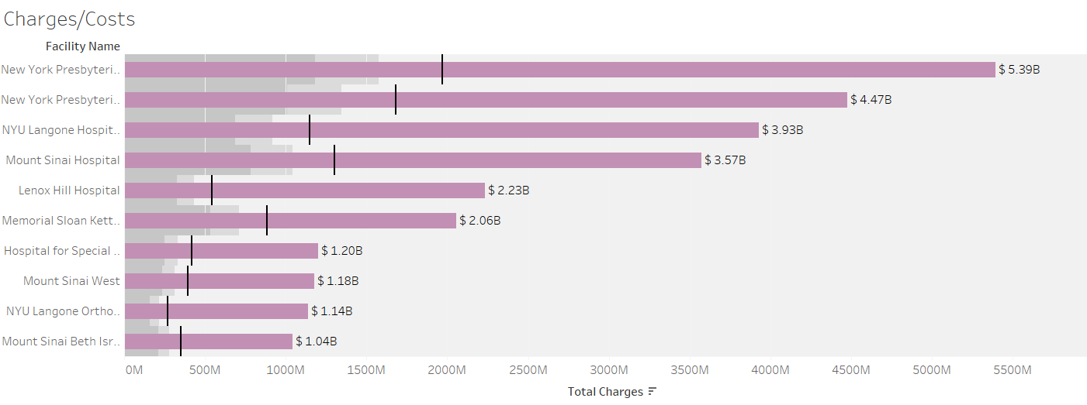
Analysis the outlier
We can also the hospitals in the county are charging the patients twice as much as it does to treat them. This is a graph of the 10 of the busiest hospitals and a comparison of the Charges / Cost

Slide 14
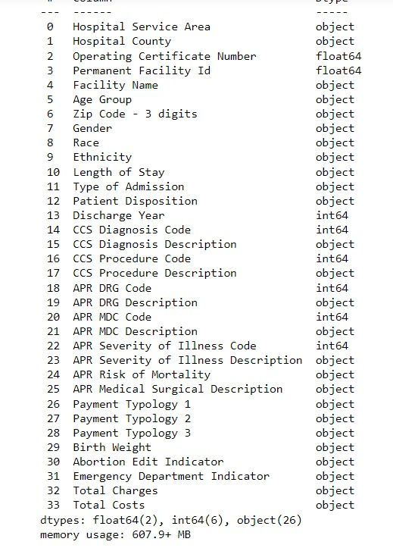
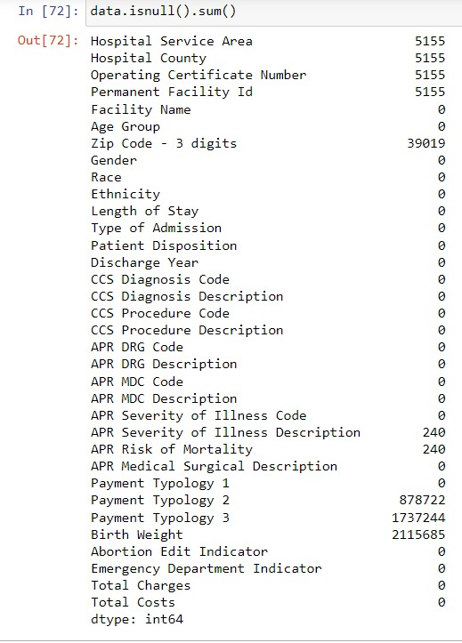
Predictive analysis
Firstly we try to obtain general information about the dataset , ie all the features and their datatypes , null values in a particular feature.

Slide 15
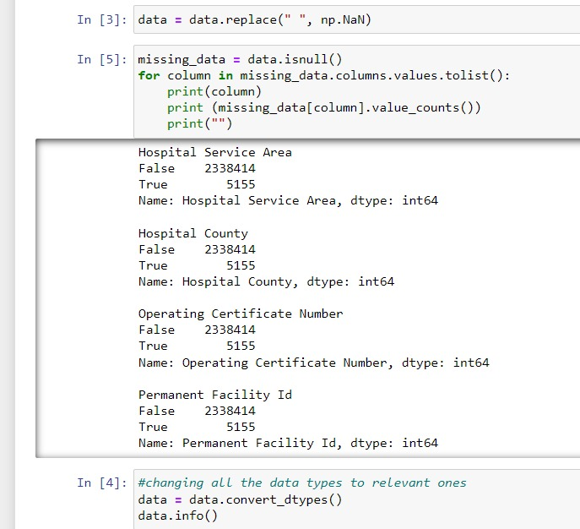
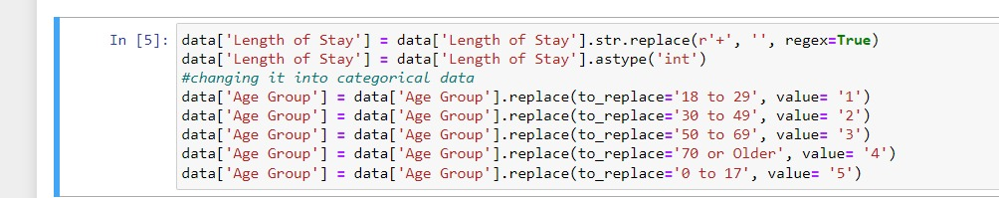
Data cleaning & data pre-processing
This was by far the biggest challenge in the dataset as the datatypes were pretty diverse and they were not ready to be used in any algorithms , following are some of the data cleaning and pre-processing steps we took.

Slide 16
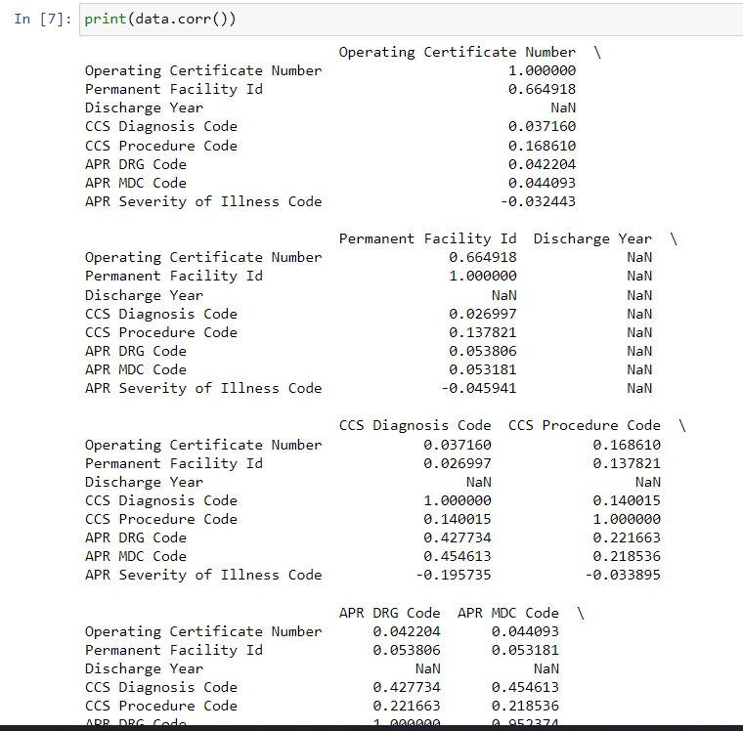
Co-relation
Our first attempt at easy predicitive model was attempting linear regression since we saw a linear trend in the length of stay vs charges and corr function also gave us a somewhat strong relation between the 2 features.

Slide 17
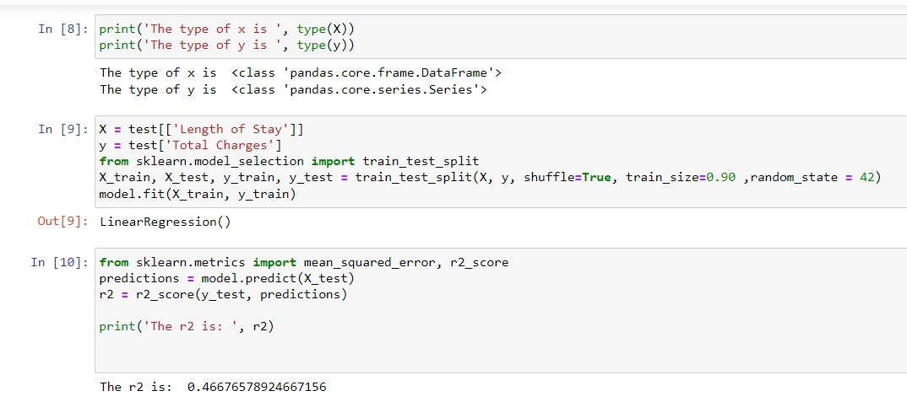
Linear regression
We measured the effectiveness of the model with the r2 value which tells us the % of data that it plotted correctly.

Slide 18
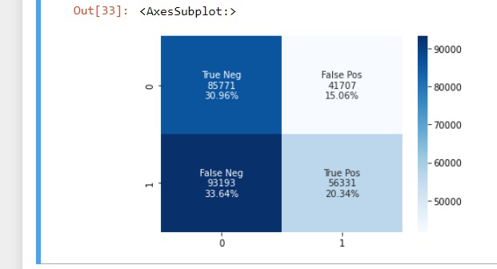
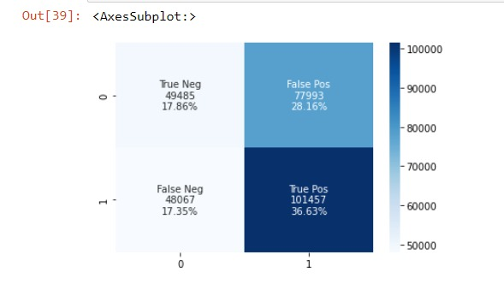
KNN analysis
Gender vs Length of Stay confusion matrix
We next tried applying knn analysis on some of the relevant features that had some relevance.
Charges vs Gender

Slide 19
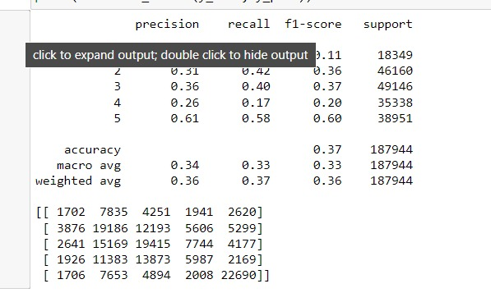
KNN analysis
Age group vs Charges confusion matrix
We next tried applying knn analysis on some of the relevant features that had some relevance.

Slide 20
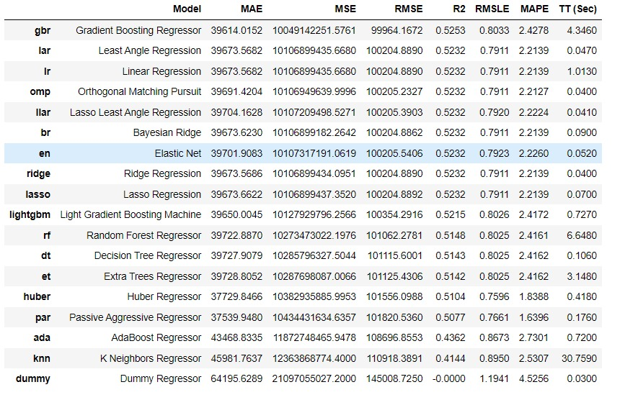
Pycaret for regression analysis
Since the linear model was not very effective at finding what we needed , we tried regression analysis using the pycaret library setting the target feature as Total charges. Additional features that we put for analysis in the regression were ‘APR Severity of Illness , ‘Length of Stay’ and ‘Emergency department indicator’

Slide 21
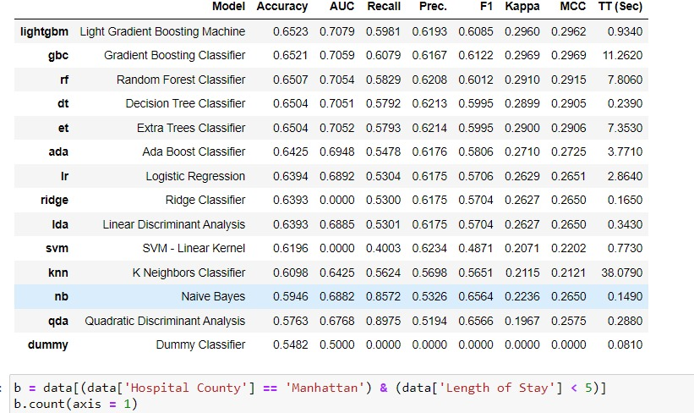
Further pycaret analysis
For this model our target variable was ‘Emegency department indicator’ and the features we used for this model were type of admission , age group , APR severity of illness.

Slide 22
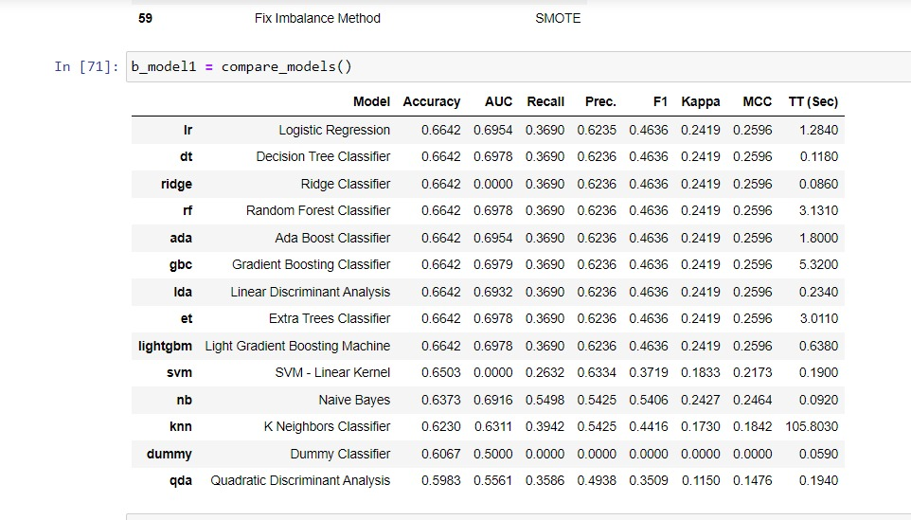
Further pycaret analysis
For this model our target variable was ‘Emegency department indicator’ and the features we used for this model were different this time we added 2 more features to the model namely – Ethnicity , APR medical surgical description

Slide 23
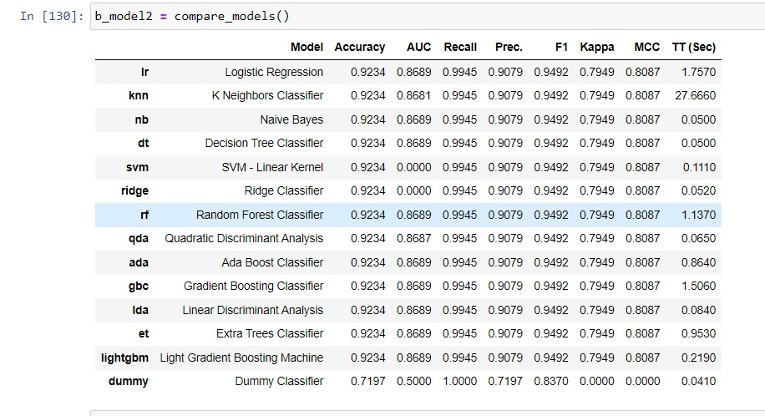
Further pycaret analysis
In this our target variable was once again emergency department indicator and the features that were used in this model were type of admission and age group.

Slide 24
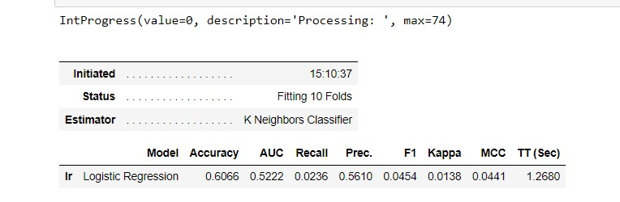
Further pycaret analysis
We have not been able to deduce a good model for our key features that will be of most use to an end user (total charges or length of stay), for this we split the length of stay below 5 and only looked at either minor or moderate APR level of injuries. The Result was still not what we hoped it to be since the dataset is very erratic.

Slide 25
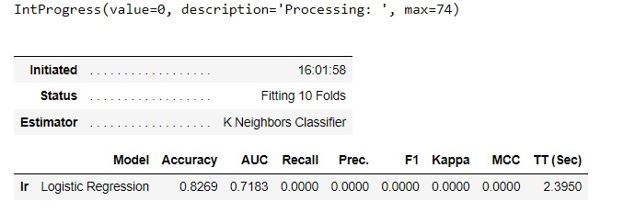
Further pycaret analysis
Our final attempt at getting better precision at length of stay was turning this into a classification problem , we merged the the number of days [1-5] in a single value and [6-10] in the next one and then we applied classification on the resulting data.

Slide 26




Summary
We had 2 or 3 key features that we wanted to predict with reasonably high accuracy , they were – ‘Emergency department indicator’ , ‘Total Charges’ and ‘Length of Stay’. We were able to predict 2 of these with reasonably high accuracy –
‘Emergency department indicator’ = 92%
‘Total charges’ = 52%
‘Length of Stay’ = 82%

Slide 27

Thank you

